Slide 1
Digital Portfolio
STUDENT NAME: KRISHNAN S
REGISTER NO AND NMID: 6CEB3CC0EE3B3129FFC40A1DC907F749
DEPARTMENT: B.SC.COMPUTER SCIENCE
COLLEGE: COLLEGE/ UNIVERSITY:GOVERNMENT ARTS COLLEGE,UDUMALPET-642126/BHARATHIAR UNIVERSITY

Slide 2
PROJECT TITLE
INTERACTIVE DIGITAL PORTFOLIO USING FWD

Slide 3
AGENDA
1.Problem Statement
2.Project Overview
3.End Users
4.Tools and Technologies
5.Portfolio design and Layout
6.Features and Functionality
7.Results and Screenshots
8.Conclusion
9.Github Link

Slide 4
PROBLEM STATEMENT
In today’s digital world, students and professionals need a platform to showcase their skills, projects, and achievements. Traditional resumes are limited and fail to demonstrate creativity or interactivity. The problem is to design a modern, responsive, and interactive portfolio website that acts as a personal brand identity for learners in Front-End Web Development (FWD).

Slide 5
PROJECT OVERVIEW
The Interactive Digital Portfolio is a web-based personal profile that highlights my journey as a student learning Front-End Development. It is designed with HTML, CSS, and JavaScript to ensure a smooth user experience, responsive design, and interactivity. The portfolio includes sections like Home, About, Projects, and Contact to give visitors a complete overview of my work.

Slide 6
WHO ARE THE END USERS ?
1.Students/Job Seekers → to showcase their skills and projects.
2.Recruiters/Employers → to review candidate’s technical and creative abilities.
3.Peers & Educators → for collaboration and assessment.

Slide 7
TOOLS AND TECHNIQUES
1.HTML5 → for semantic structure.
2.CSS3 → for styling, layout, and responsiveness.
3.JavaScript (ES6) → for interactivity and form validation.
4.GitHub → for version control and project hosting.
5.VS Code → as the development environment.

Slide 8

PORTFOLIO DESIGN AND LAYOUT
1.Navbar → sticky navigation with responsive menu toggle.
2.Home Section → introduction and call-to-action.
3.About Section → profile photo and short description.
4.Projects Section → grid-based cards showcasing sample projects.
5.Contact Section → interactive form with validation.
6.Footer → copyright and links.
7.Responsive Design → mobile, tablet, and desktop-friendly.

Slide 9

FEATURES AND FUNCTIONALITY
✔ Responsive layout with mobile navigation toggle.
✔ Clean, modern design with hover animations. ✔ Project cards using CSS Grid. ✔ Interactive contact form with JS validation.
✔ Form feedback with real-time success/error messages.
✔ Organized code with modular CSS and JS.

Slide 10
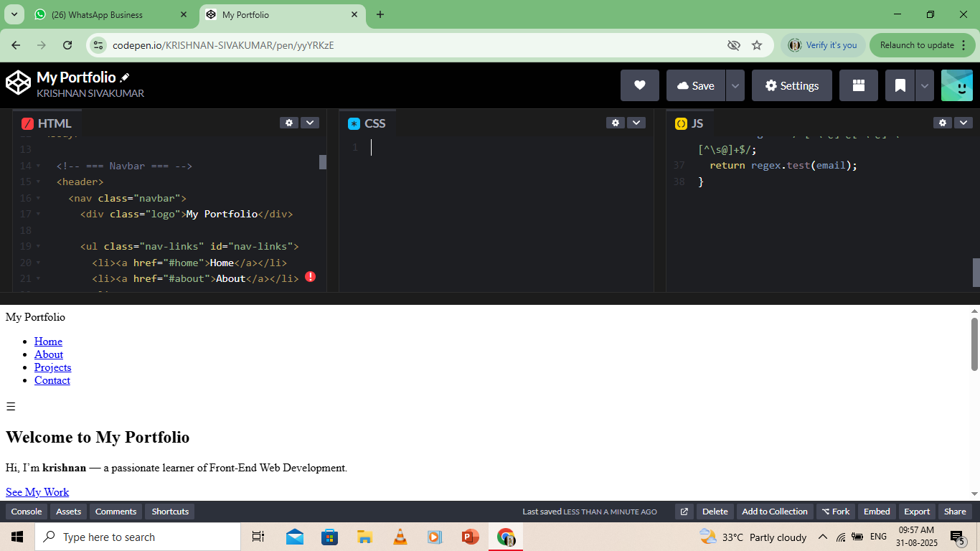
RESULTS AND SCREENSHOTS
The portfolio successfully runs on different devices with smooth navigation and interactive elements.
10
1.Home Page – welcoming layout with CTA button.

Slide 11
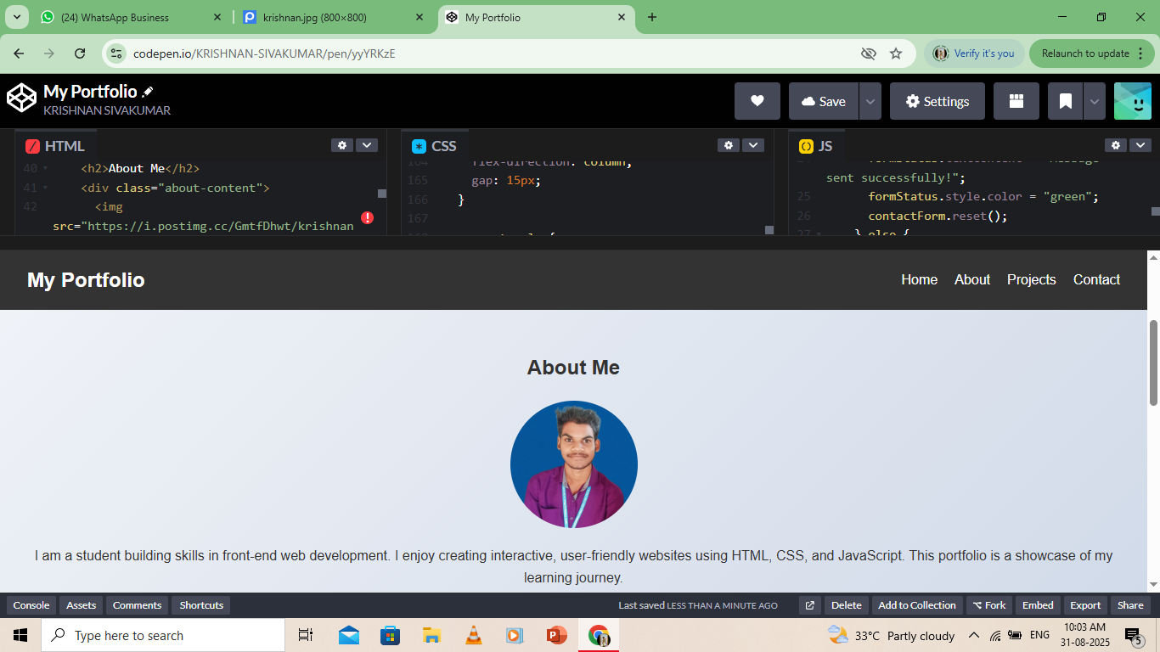
2.About Section – profile image + description.

Slide 12
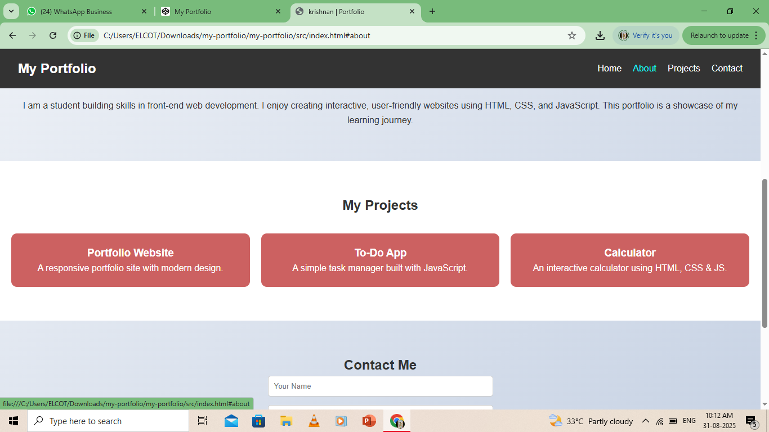
3.Projects Section – responsive grid with hover effects.

Slide 13
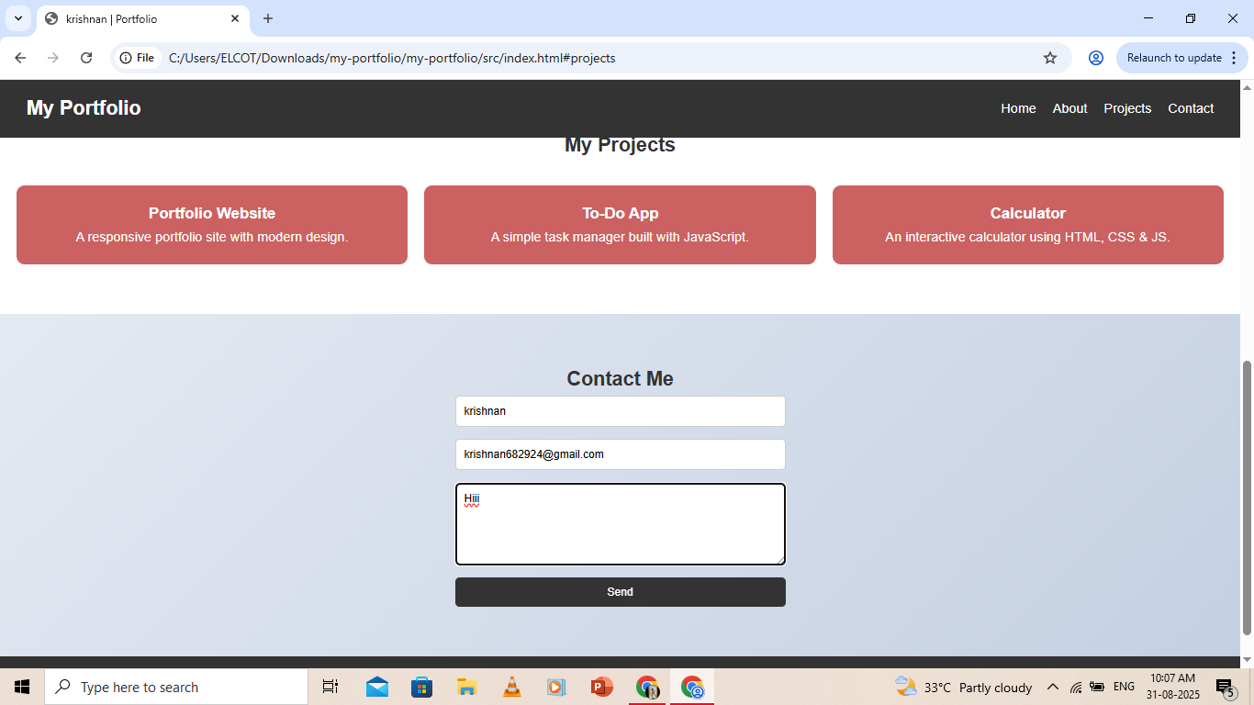
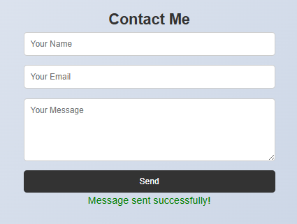
4.Contact Section – form validation in action.

Slide 14
CONCLUSION
The Interactive Digital Portfolio is a simple and effective way to showcase skills, projects, and achievements. It is responsive, user-friendly, and helps create a professional online presence.

